Slide 1

Select Topics in Python
Arithmetic Expressions
Adwith Malpe
Notes:
‹#›

Slide 2
Objectives
Objectives
What are Arithmetic Expressions?
Order of Operations
Demo

Slide 3
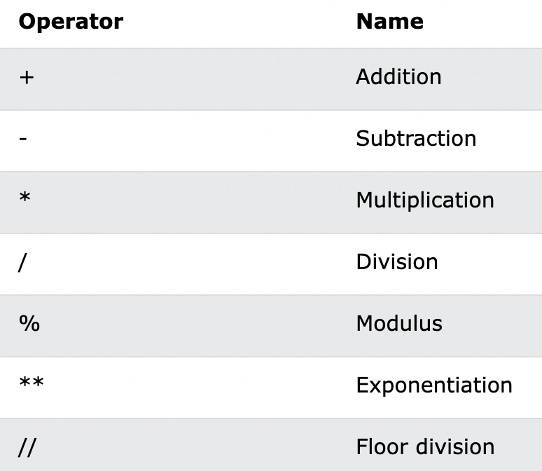
Arithmetic Expressions
What are Arithmetic Expressions?
A branch of mathematics that involves the study of numbers and the operations of numbers
Arithmetic Operators in Python:

Slide 4
Order of Operations
Order of Operations
Python Operators Precedence Rules:
P - Parenthesis
E - Exponentiation
M - Multiplication
D - Division
A - Addition
S - Subtraction
//, % correlate with M and D, therefore it has the same order of precedence
NOTE: Division will return a float value in python (Python 3). To perform integer decision (getting an integer back as a result), use //

Slide 5
Demo
Demo

